Slide 1

UNIVERSITI TEKNOLOGI MALAYSIA
TOPIC 3.1 : DEVELOPING APPLICATION BASED ON STAKEHOLDER/CUSTOMER PROBLEM
Combination of Design Thinking and User Stories

Slide 2
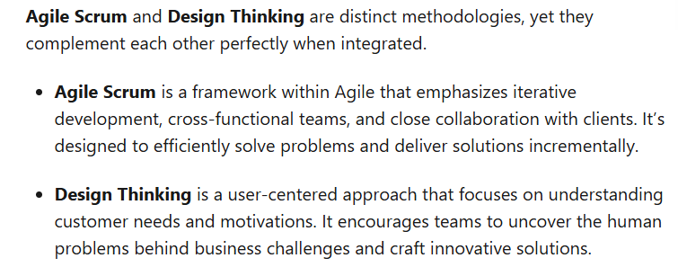
Integrating Design Thinking into Scrum Development
Website URL: https://www.linkedin.com/pulse/how-integrate-design-thinking-scrum-development-aleksandre-oniani

Slide 3
Design Thinking
Empathized
Define
Ideate
Prototype
Test

Slide 4
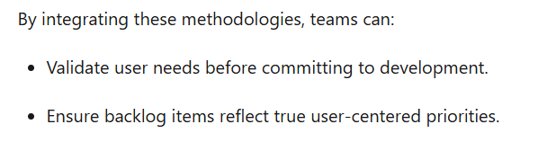
Why Combine Scrum and Design Thinking?

Slide 5
Design Thinking Explained
Reference: Alex Cowan - Agile and Design Thinking

Slide 6
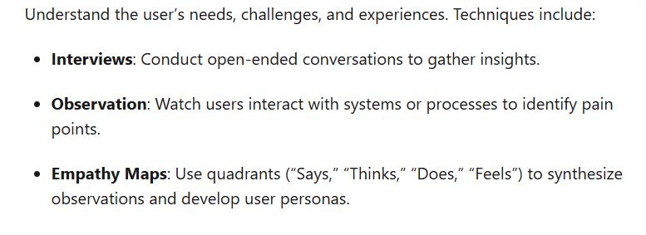
Empathized

Slide 7

Empathized

Slide 8
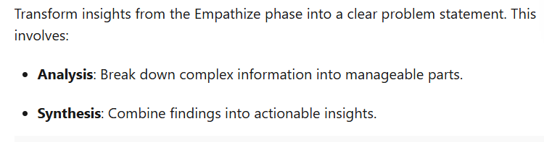
Define

Slide 9
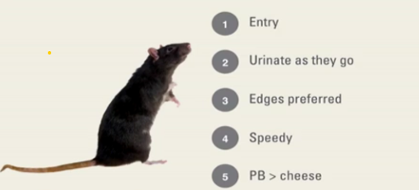
Define - synthesis/ findings about mice

Slide 10
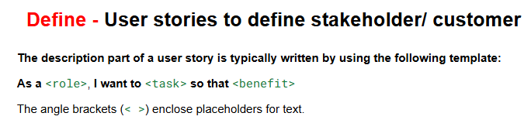
Define Using User Stories

Slide 11
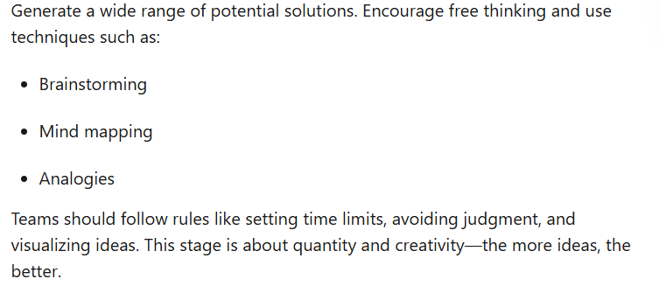
Ideate

Slide 12

Prototype and Test

Slide 13

Test

Slide 14
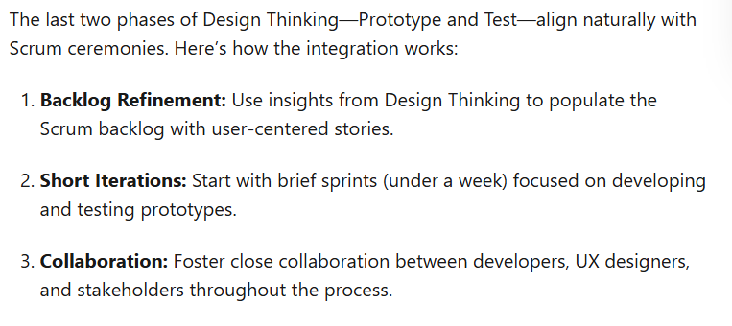
Synchronizing Design Thinking and Scrum

Slide 15
Ride Sharing apps for Car Pooling (sustainability initiative)
In Class Activity

Slide 16
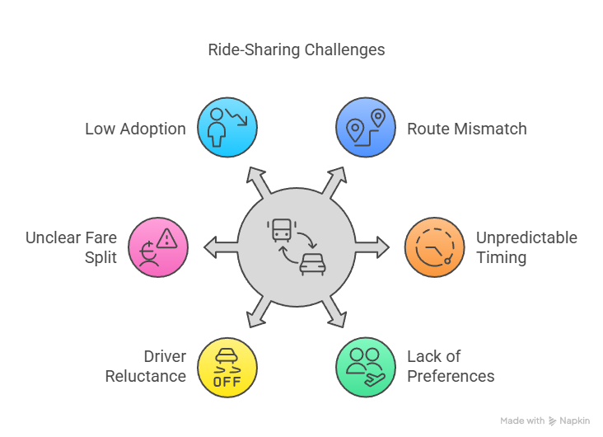
EMPATHY - Understand the as-is problem of your customer/stakeholder
Currently, triders with significantly different routes or destinations paired togather , leading to long detours and extended travel times that discourage users from choosing carpooling.
Drivers are hesitant to accept carpooling trips due to increased complexity, time commitment, and perceived lower earnings
Riders in a carpool have inconsistent pickup and drop-off schedules, resulting in delays and unpredictability,
The fare split among carpool riders is not clearly explained or visibly fair,
Currently to do car pooling manually - lacks support for users to set preferences (e.g., quiet rides, no pets, female-only carpools), leading to dissatisfaction and privacy concerns.
Users are not sufficiently incentivized to choose carpooling over solo rides, leading to low adoption rates

Slide 17
Define - User stories to define stakeholder/ customer
The description part of a user story is typically written by using the following template:
As a <role>, I want to <task> so that <benefit>
The angle brackets (< >) enclose placeholders for text.

Slide 18
Ideate- User stories to define stakeholder/ customer
As a <rider>, I want to <be able to be assigned to riders with the same destination as I am> so that <I can have an efficient journey to my destination>
The angle brackets (< >) enclose placeholders for text.

